Slide 1
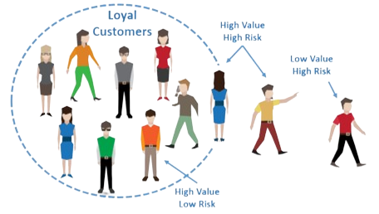
CUSTOMER CHURN PREDICTION
TEAM MEMBERS:-
1.HERISH CHAUDRAY – PROJECT MANAGER
2. ROSHINI – ASSISTANT MANAGER
3. NASRUL FITRI – PROGRAMMER
4. FARHAN HAFIZI – TESTER

Slide 2
INTRODUCTION
The Customer attrition Prediction System is a strategic project that uses artificial neural networks (ANN) to anticipate customer attrition by analysing historical customer data and predicting churn. This proactive approach empowers businesses to optimize resource allocation, enhance customer retention strategies, and ultimately improve overall profitability.

Slide 3
UNDERSTANDING THE PROBLEM
COMPLEX DATA PATTERN
INEFFICIENT RESOURCE ALLOCATION
LACK OF OBJECTIVE SOLUTION
Developing an accurate ANN model faces challenges in addressing complex data patterns, feature identification, and parameter fine-tuning.
Inefficient resource allocation arises due to the inability to effectively identify and prioritize customers most likely to churn.
Growing importance for an objective and consistent solution to improve the business.

Slide 4
BUSINESS CASE
Executive Summary | The Customer attrition Prediction System is a strategic project that uses artificial neural networks (ANN) to anticipate customer attrition by analysing historical customer data and predicting churn. This proactive approach empowers businesses to optimize resource allocation, enhance customer retention strategies, and ultimately improve overall profitability.
Problem statements | Developing an accurate ANN model faces challenges in addressing complex data patterns, feature identification, and parameter fine-tuning. Inefficient resource allocation arises due to the inability to effectively identify and prioritize customers most likely to churn. The lack of objective solution where there is an importance for an automated system that can provide objective solution to improvise the business
Benefits | Increased Customer Retention: Accurate predictions enable targeted retention strategies, reducing churn rates and preserving customer relationships. Resource Optimization: Improved allocation of resources, leading to cost savings by focusing efforts on customers with a higher likelihood of churn. Competitive Edge: Enhances business competitiveness through data-driven decision-making and proactive customer management.
Costs and Expected Return of Investment : | Budget of RM 1,087,531 only Expected ROI: To gain with a 20% of return in the third year : ~ RM 216,306

Slide 5
PROJECT CHARTER
Project Name: Customer Churn Prediction System
Project Description: | This project aims to build an intelligent system capable of analysing historical customer data and predicting the likelihood of churn. By employing ANN, the model aims to capture intricate patterns and relationships within the data, providing more accurate predictions compared to traditional models. This system analyses the historical customer data, predicts churn, and empowers businesses to proactively retain customers. The project involves data preprocessing, feature engineering, ANN model training, evaluation, integration with a simple and intuitive user interface and system testing to validate the system’s accuracy performance.
Project Objectives: | To develop an ANN model that accurately predict which customers are likely to churn. To help businesses optimise resource allocation by focusing their efforts and resources on customers who are most likely to churn. To continually refine the churn prediction model by monitoring the performance of an ANN model and increase the accuracy of the system
Success Criteria: | High Prediction Accuracy: The customer churn prediction system should achieve a high overall accuracy in predicting the customer churn. Resource Allocation Improvement: The system should be able to demonstrate a measurable improvement in resource allocation efficiency with retaining customers who are less likely to churn. Continuous Model Refinement: The system establishes updates to the model, incorporating new customer data and insights to accuracy over time and should be able to adapt to changes in customer behavior.

Slide 6
PROJECT CHARTER
Budget: | Budget of RM 1,087,531 only
Deliverables: | User Manual and Training Materials System Documentation Testing and Quality Assurance Reports Technical Support
Milestones: | System Design and development completed by end of Week 7 User acceptance testing completed by end of Week 10 System Implementation and Rollout completed by end of Week 13
Potential Risks: | Data Quality and Availability: Incomplete or inaccurate customer data could compromise the accuracy of the churn prediction model. Model Complexity and Overfitting: The ANN model may become overly complex, leading to overfitting on the training data and poor generalization to new data. Lack of Stakeholder Engagement: Inadequate involvement and feedback from stakeholders on project progress may result in misaligned expectations.

Slide 7
AI TOOLS AND SOFTWARE
01
MACHINE LEARNING FRAMEWORKS
DATA PROCESSING AND ANALYSIS
DEEP LEARNING ARCHITECTURE
DATA VISUALIZATION
IMPORT DATASET
Pandas for importing datasets used
TensorFlow, PyTorch and Scikit-learn for implementing machine learning algorithms.
Numpy for data manipulation
Matplotlib for presenting insights of data
Multilayer perceptron
05
02
04
03

Slide 8
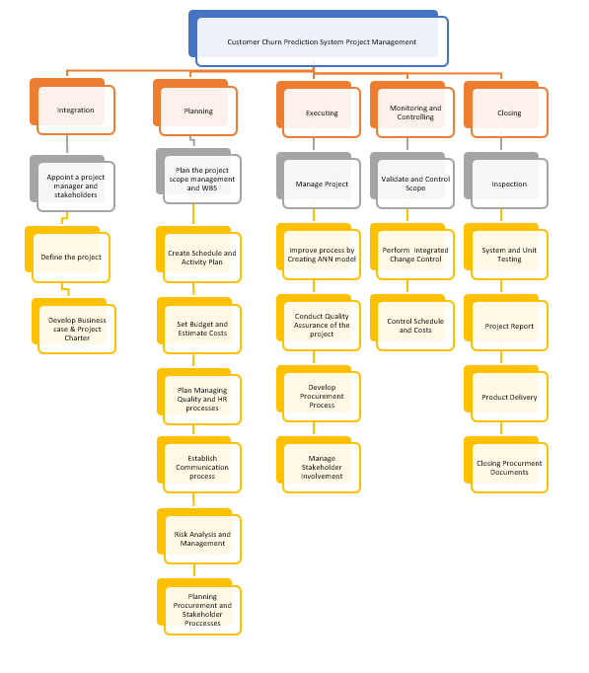
WORK BREAKDOWN STRUCTURE

Slide 9
COST ESTIMATE
01
02
03
04
PROJECT MANAGMENT
HARDWARE & SOFTWARE
TESTING
TRAINING
05
RESERVES

Slide 10
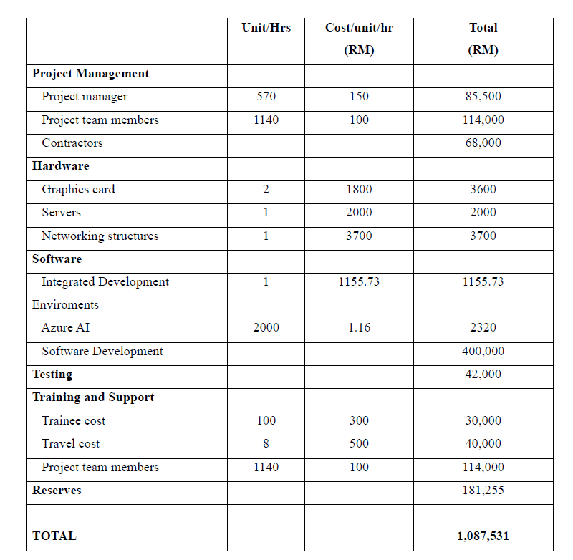

Slide 11
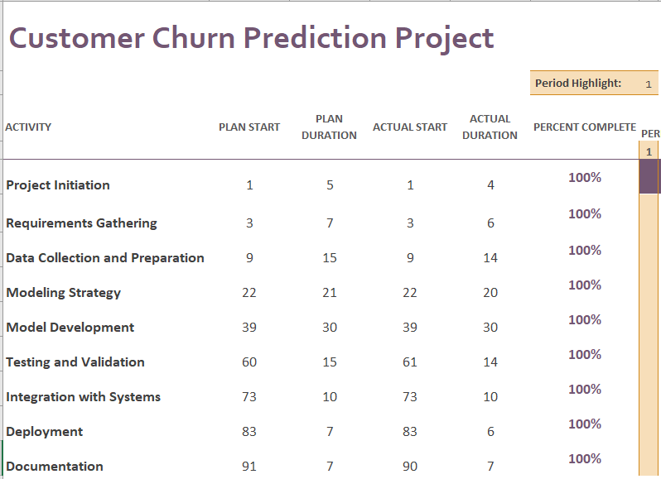
GANTT CHART SCHEDULING
95 DAYS
9 PHASES

Slide 12
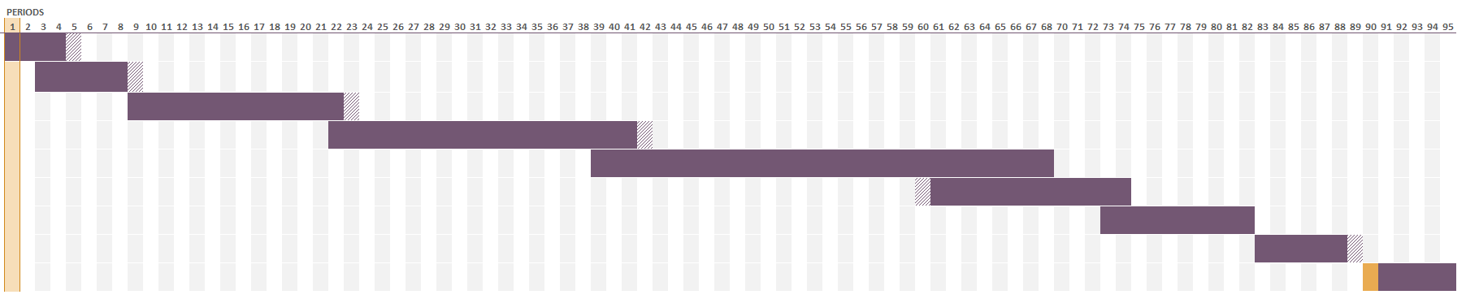

Slide 13
RISK MITIGATION
Risks | Risk Mitigation
Data Quality and Availability: | Conduct thorough data quality assessments, invest in data cleansing processes, and establish backup plans for addressing missing or flawed data.
Model Complexity and Overfitting: | Implement regularization techniques, cross-validation, and model simplification strategies to prevent overfitting. Regularly monitor the model's performance on unseen data.
Lack of Stakeholder Engagement | Regularly update stakeholders on project progress, seek their input during key decision points, and encourage open communication channels. Conduct regular review meetings to ensure alignment with business objectives.

Slide 14
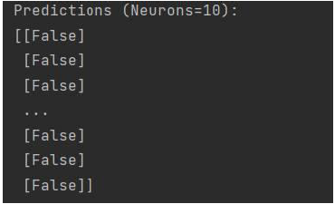
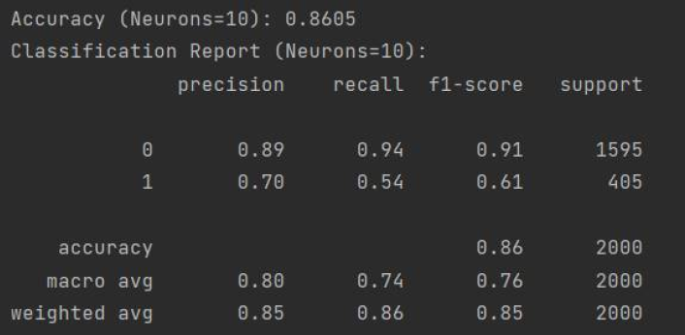
EXPECTED OUTCOME
PREDICTIONS
SYSTEM PERFORMANCE

Slide 15
CONCLUSION
Customer churn prediction using Artificial Neural Networks (ANN) has proven to be a powerful tool for businesses in forecasting and mitigating customer attrition.
By harnessing the capabilities of ANN models, companies can analyse vast amounts of historical data, identify relevant patterns, and make accurate predictions regarding customer churn.
Our project has reached significant milestones with the formal acceptance of our work .

Slide 16
REFERENCES
How to make a Gantt chart in Microsoft project (MP). (2023, October 21). Process Street. https://www.process.st/how-to/make-a-gantt-chart-in-microsoft-project/
Work breakdown structure (WBS): The ultimate guide (with examples). (2023, August 19). ProjectManager. https://www.projectmanager.com/guides/work-breakdown-structure
Mohadarkar, S. (2023, August 14). Implementing artificial neural Network(Classification) in Python from scratch. Analytics Vidhya. https://www.analyticsvidhya.com/blog/2021/10/implementing-artificial-neural-networkclassification-in-python-from-scratch/
Badole, M. (2023, March 31). Customer churn prediction using artificial neural network. Analytics Vidhya. https://www.analyticsvidhya.com/blog/2021/10/customer-churn-prediction-using-artificial-neural-network/

